Slide 1

Big Data and
Advance Analytics
What we have done

Slide 2


Artificial Intelligence
10 February 1996
Machine Learning
Artificial Narrow Intelligence
Artificial General Intelligence
Artificial Intelligince
15 March 2016
Notes:
https://www.scientificamerican.com/article/20-years-after-deep-blue-how-ai-has-advanced-since-conquering-chess/

Slide 3
Artificial Intelligence

The ability of a digital computer or computer-controlled robot to perform tasks commonly associated with intelligent beings.

The machines that can actually think and perform tasks on its own just like a human being.
Machine Learning
−
Artificial Narrow Intelligence (ANI) also known as “Weak” AI is the AI that exists in our world today. Narrow AI is AI that is programmed to perform a single task — whether it’s checking the weather, being able to play chess
Artificial Narrow Intelligence
Artificial Narrow Intelligence

The field of study that gives computers the ability to learn without being explicitly programmed
Artificial Intelligince
Notes:
https://medium.com/@chethankumargn/artificial-intelligence-definition-types-examples-technologies-962ea75c7b9b

Slide 4
Types of Machine Learning

Supervised
Supervised Learning: “The outcome or output for the given input is known before itself” and the machine must be able to map or assign the given input to the output.

Unsupervised
The outcome or output for the given inputs is unknown”, here input data is given and the model is run on it.
✶
Reinforcement
The machine is exposed to an environment where it gets trained by trial and error method, here it is trained to make a much specific decision. The machine learns from past experience and tries to capture the best possible knowledge to make accurate decisions based on the feedback received.
Notes:
https://searchenterpriseai.techtarget.com/definition/reinforcement-learning

Slide 5
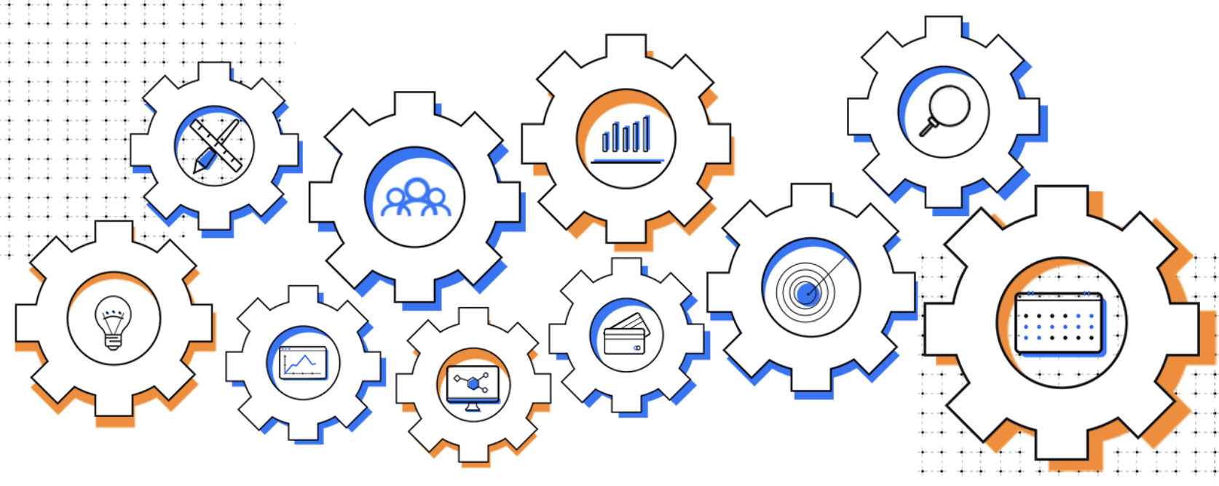
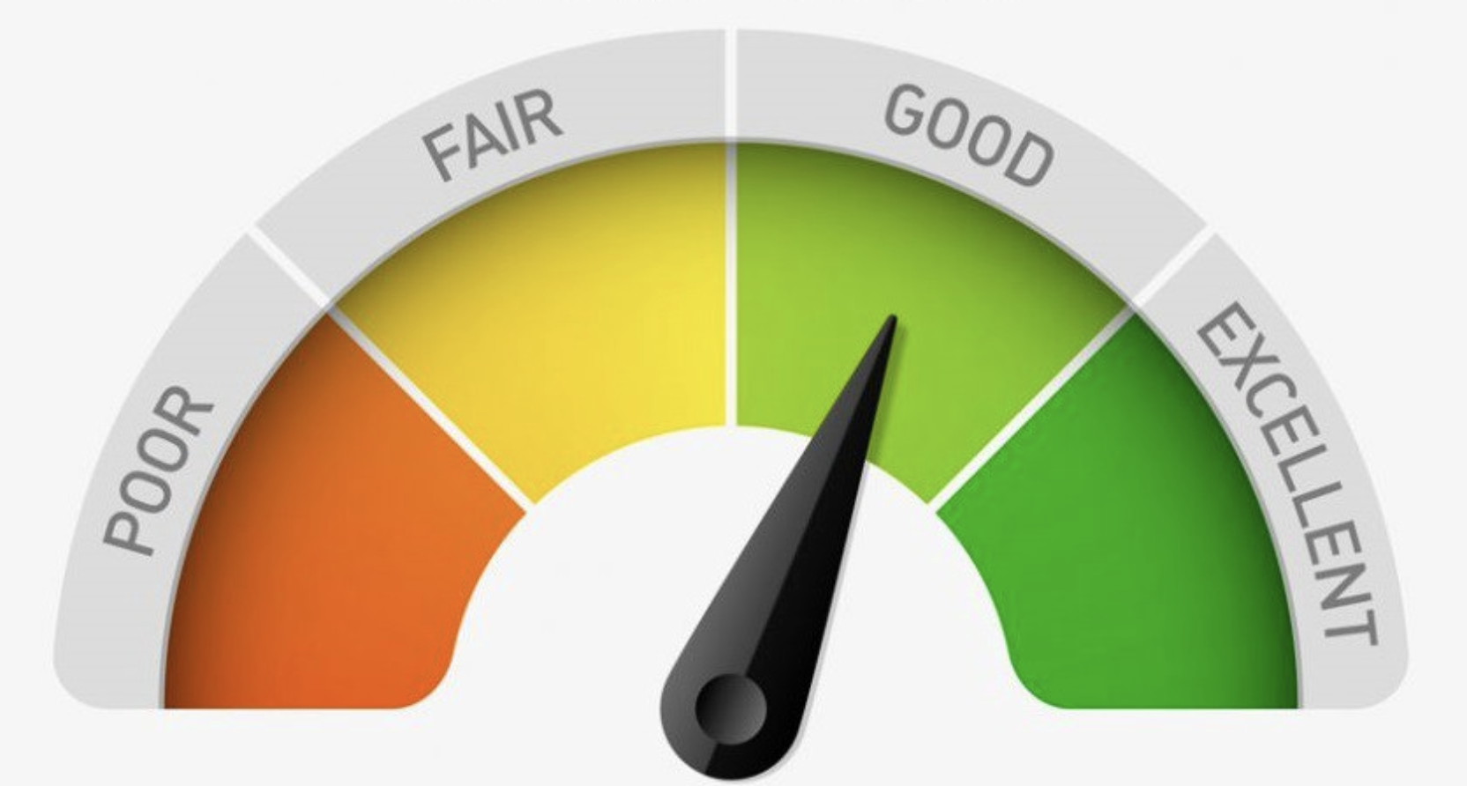


Machine Learning Use Cases in Finance Sector
Process Automation
Chatboots
Call Center automation
Paperwork automation
Credit Scoring and Underwriting
Marketing
Churn models
Propensity models
Dynamic e-mails
Dynamic pricing
Security
Detecting frauds
Suspicious account behavior
Financial monitoring
Network security
Notes:
https://towardsdatascience.com/machine-learning-in-finance-why-what-how-d524a2357b56
https://thefinancialbrand.com/71350/ai-machine-learning-analytics-marketing-banking-trends/

Slide 6
Machine Learning Process Flow
Model Validation
Project Scope
Train - Validation - Test Split
Definition of process aim and target function
We split our data
We validate our model on validation set based on metrics and analyze it
−



⬅

Data Preparation
Model&Feature Selection
Model Production
Try to find best algorithms and robust features based on metrics
Take best model to production
Decesion of whic data source can be used. Feature Extraction, Data Cleaning, Outliar, noise detection(it takes most of the time)
Notes:
dedicates

Slide 7
Which Data Source We Can Use, Which We can not
- We need to have data historically in the system.
- We need to know results for training dataset.
- We can predict cheque results if data has not target, but can not validate or test it.


Target

◆

Slide 8
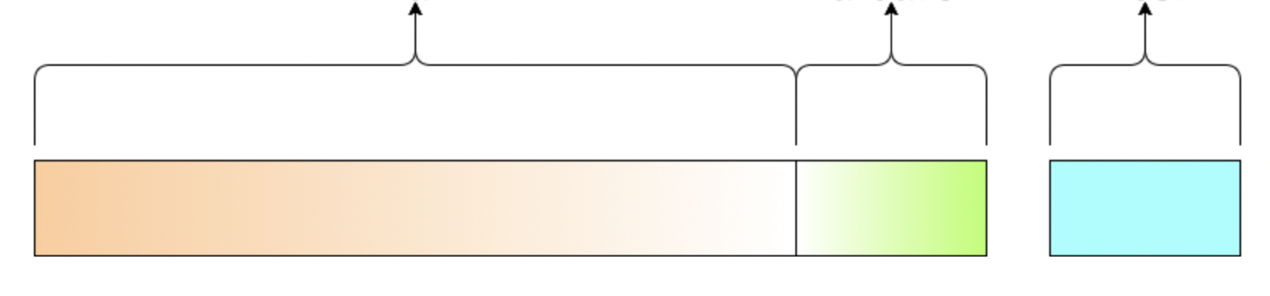
Train, Validation, Test Split
Train
Validation
Test
Training Dataset: The sample of data used to fit the model.
Validation Dataset: The sample of data used to provide an unbiased evaluation of a model fit on the training dataset while tuning model hyperparameters. The evaluation becomes more biased as skill on the validation dataset is incorporated into the model configuration.
Test Dataset: The sample of data used to provide an unbiased evaluation of a final model fit on the training dataset.
Notes:
https://towardsdatascience.com/train-validation-and-test-sets-72cb40cba9e7

Slide 9
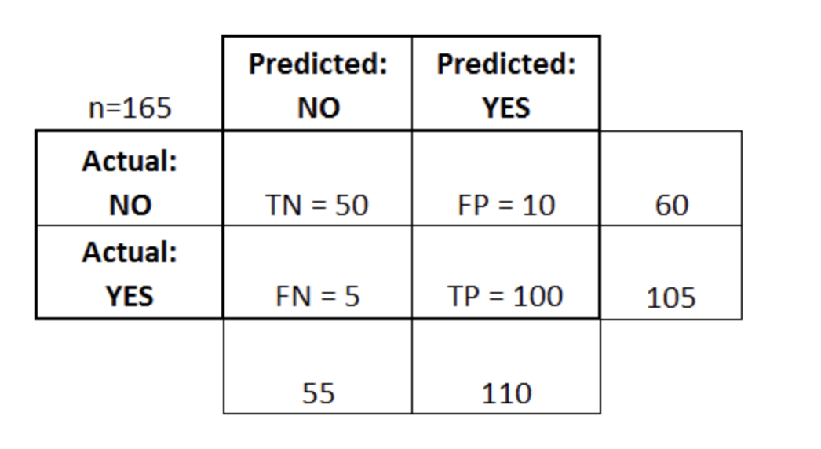
Model Validation – Confusion Matrix
Accuracy: Overall, how often is the classifier correct?
(TP+TN)/total = (100+50)/165 = 0.91
True Positive Rate: When it's actually yes, how often does it predict yes?
TP/actual yes = 100/105 = 0.95
also known as "Sensitivity" or "Recall"
False Positive Rate: When it's actually no, how often does it predict yes?
FP/actual no = 10/60 = 0.17
Precision: When it predicts yes, how often is it correct?
TP/predicted yes = 100/110 = 0.91
F Score: This is a weighted average of the true positive rate (recall) and precision
ROC Curve: This is a commonly used graph that summarizes the performance of a classifier over all possible thresholds. It is generated by plotting the True Positive Rate (y-axis) against the False Positive Rate (x-axis) as you vary the threshold for assigning observations to a given class.
Notes:
https://www.dataschool.io/roc-curves-and-auc-explained/

Slide 10
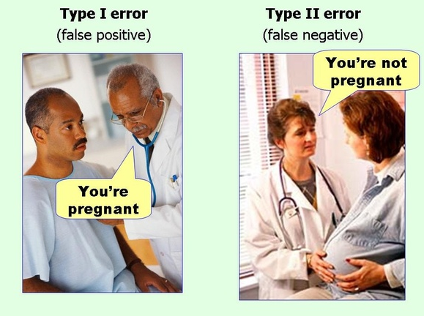
Model Validation – Confusion Matrix Examples
Notes:
https://paultebraak.wordpress.com/2013/10/31/understanding-the-lift-chart/
https://stats.stackexchange.com/questions/17119/lift-measure-in-data-mining

Slide 11
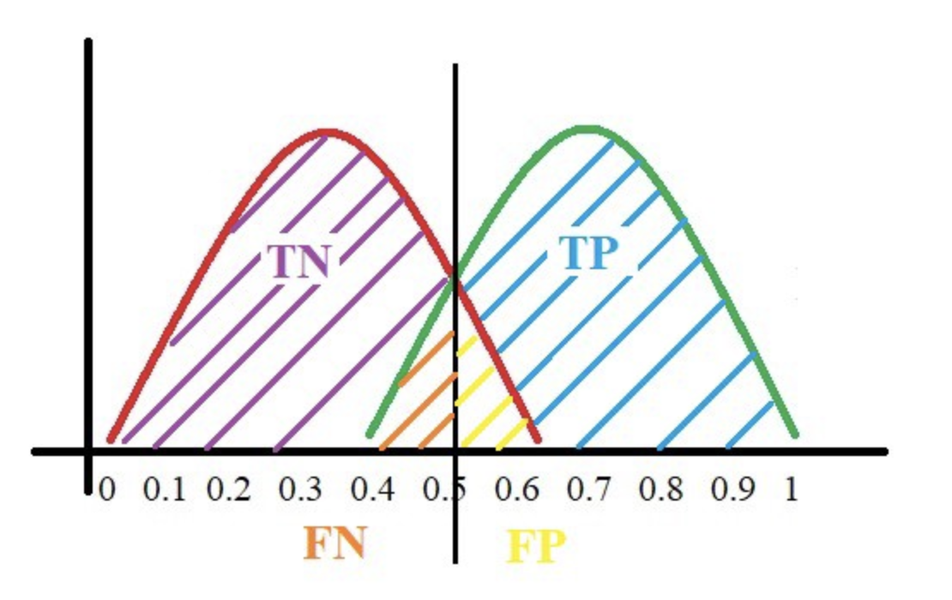
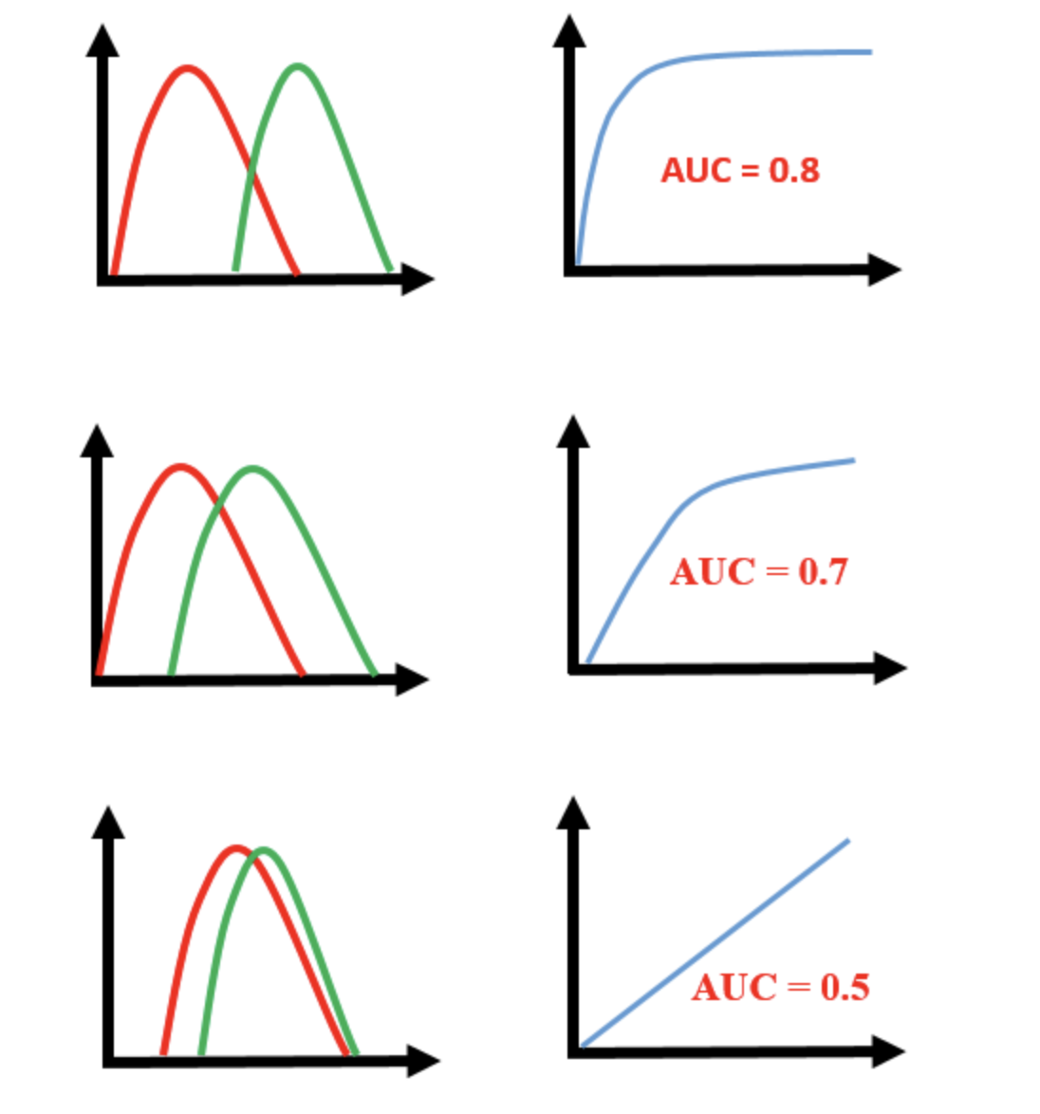
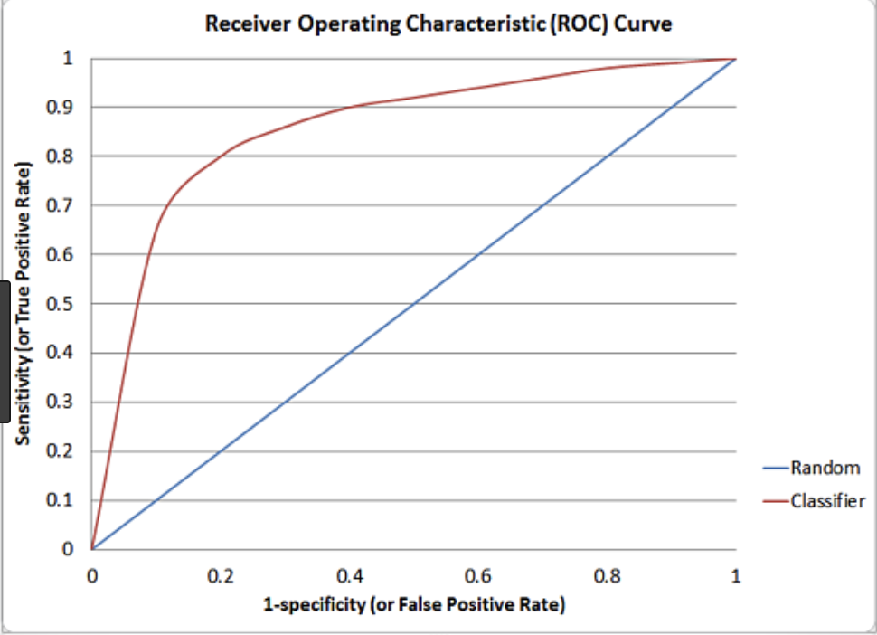
Model Validation – ROC Curve
Notes:
https://medium.com/greyatom/lets-learn-about-auc-roc-curve-4a94b4d88152
https://www.dataschool.io/roc-curves-and-auc-explained/

Slide 12
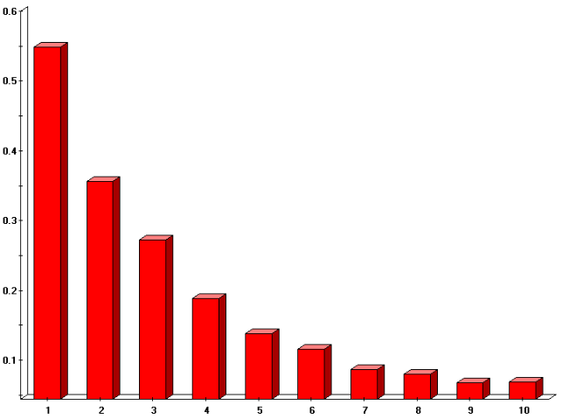
Model Validation – Lift
Non Paid Ratio
Deciles
Notes:
https://paultebraak.wordpress.com/2013/10/31/understanding-the-lift-chart/
https://stats.stackexchange.com/questions/17119/lift-measure-in-data-mining

